Slide 1
Quick and Dirty Cybersecurity
Things Your Small/Medium Sized Business Can Do Tomorrow

Slide 2

Whoami
G W Ray Davidson
Engineer, Georgia Tech/Purdue
(When the earth and internet were new)
Pharmaceutical Scientist
(Silicon Valley before the earthquake)
IT Project Leader
Professor – Networking & Security (Purdue)
Dean, SANS Technology Institute
VP, Knowledge Management, Syncurity
(Startup in N Virginia/DC)
Intelligent Threat, PhD, CISSP, GIAC 0x0A

Slide 3
Security Frameworks
Internal Corporate Standards & Guidelines
Federal Information Security Modernization Act (FISMA)
“Recommended Security Controls for Federal Information Systems”
NIST SP800-53rev4
Critical Security Controls for Effective Cyber Defense
Council on Cybersecurity

Slide 4
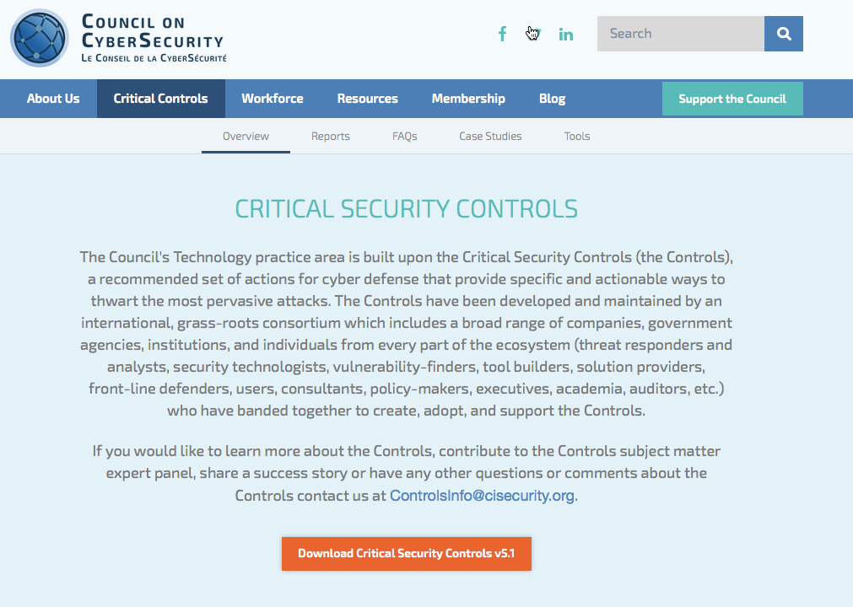

Slide 5
Quick Wins from the CSC (Courtesy ASD)
Hardware Inventory
Control and monitor access
Software Inventory
Add’l benefit – license management
Secure HW & SW Configuration
Limited admin privileges
Continuous Vulnerability Management and Remediation
Rapid patching
Notes:
Australian Signals Directorate

Slide 6
Know Your Network
Control and monitor access
Control and monitor configuration
Determine a baseline
Detect and remediate excursions
Rinse and repeat (Continuous Monitoring)

Slide 7
1. Hardware Inventory (Nice to have)
Network Address
Machine Name
System Purpose
System Owner
Responsible Department

Slide 8
1. Hardware Inventory - How
Baseline
Monitoring
Tools
Spiceworks
OSSIM
nmap

Slide 9
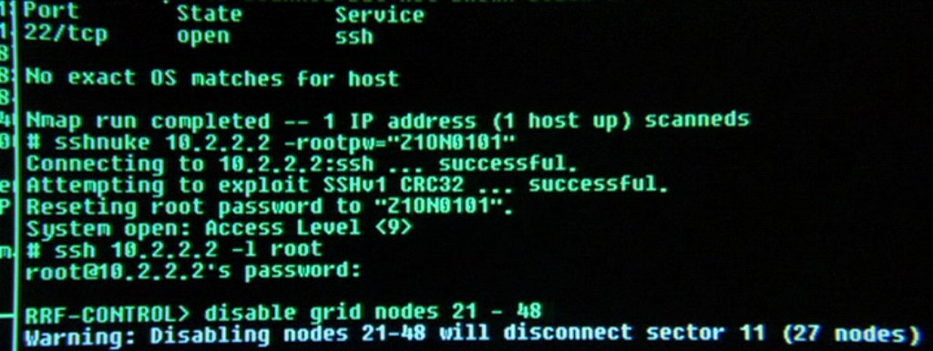
1. Nmap scripting
Baseline scan
nmap –sL –sn –oX hardware_baseline.xml 192.168.1.0/24
Periodic scan
nmap –sL –sn –oX hardware_current.xml 192.168.1.0/24
Compare to baseline
Ndiff hardware_baseline.xml hardware_current.xml > hardware_diff.txt
Regularly monitor for new devices on the network
Notes:
-sL does a “list” scan
-sn disables port scan
-oX XML output

Slide 10
2. Software Inventory – For each system
Underlying OS
Applications installed
Tied to hardware asset inventory

Slide 11
2. Software Inventory - How
Baseline
Monitoring
Tools
Windows Management Instrumentation Command-Line (WMIC)
Spiceworks
OSSIM

Slide 12

2. WMIC Scripting
Baseline scan
wmic product list brief >software_baseline.txt
Periodic scan
wmic product list brief >software_current.txt
Compare to baseline
compare-object (get-content software_baseline.txt) (get-content software_current.txt) > software_diff.txt
Regularly monitor for new applications on the network

Slide 13
3. Secure HW & SW Config - Need
Standard image
OS and patch level
Software application inventory
Patch Management system

Slide 14
3. Secure HW & SW Configuration – How
Define and create a standard image(s) for the organization
See the HW and SW inventory already performed
Install that image on all newly issued hardware
Monitor for changes and remediate
Tools
Puppet
WMIC
Microsoft Baseline Security Analyzer (MBSA)

Slide 15
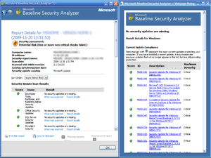
3. MBSA Scenario
Install MBSA throughout the organization using Active Directory GPO
http://www.microsoft.com/mbsa
Script to run MBSA
c:\program files\microsoft baseline security analyzer\mbsacli.exe" -c %computername%
/o %%D%%-%%C%% > c:\mbsarun.txt
copy /y "%userprofile%\securityscans\*.xml" \\dc5\mbsadata
del "%userprofile%\securityscans\*.xml"
GPO to install and run the local script
Monitor the results (Possibly a web page of the XML data)

Slide 16
4. Continuous Vulnerability Management and Remediation – Needs
Inventory of relevant OS and applications
Regular updates on vulnerabilities and patches
Reliable (automated?) method of applying patches
Monitoring capability

Slide 17
4. Continuous Vulnerability Management and Remediation
Regularly scan for known vulnerabilities (CVE)
Common Vulnerability Scoring System (CVSS)
Use automated patch management tools
OS and applications
Monitor logs to make sure patches are installed successfully
Tools
Nessus (free for noncommercial/home users)
OpenVAS (fork of Nessus)

Slide 18
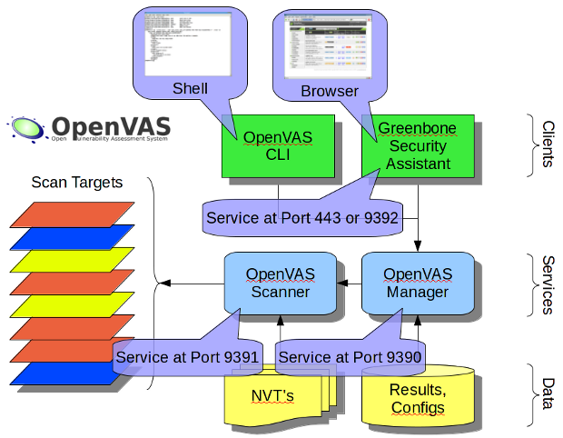
4. Vulnerability Management - OpenVAS
Fork of Nessus, a mature vulnerability scanner
CLI + GUI (Greenbone)
Network Vulnerability Testing (NVT)
Updated vulnerability information via OpenNVT feed
http://www.openvas.org/

Slide 19

Why Quick & Dirty? Our work ethic

Slide 20
References
NIST SP800-53 – http://nvlpubs.nist.gov/nistpubs/SpecialPublications/NIST.SP.800-53r4.pdf
Critical Security Controls - http://www.counciloncybersecurity.org/critical-controls/
This presentation - https://github.com/RayDavidson/presentations

